Slide 1

RETAIL RX
C C ' S C L O T H I N G R E T A I L E R

Slide 2



AGEN DA
Executive Summary Descriptive Statistics Clustering Analysis Predictive Modeling Conclusion

Slide 3
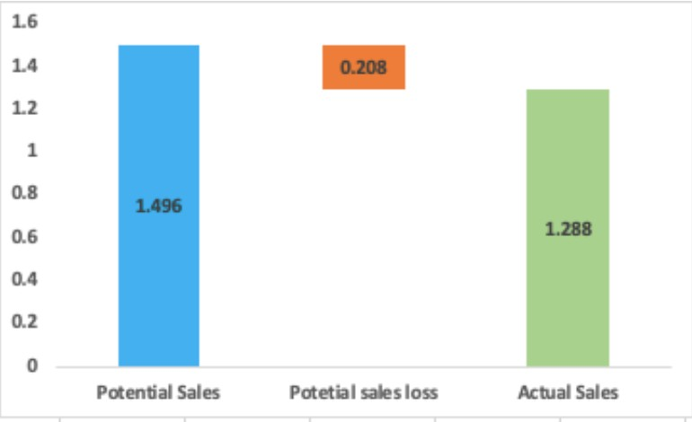
EXECUTIVE SUMMARY
CC's is a prominent clothing retailer with a vast presence across the United States, offering a diverse range of products in all of its stores. However, the management team is worried about certain stores that have lower gross margins and excessive clearance inventory.
The stores in 2019 made sales revenue of 1.28 M USD.
20.45% of the items were put on Clearance Sale which together had generated sales worth 0.188 Mn USD. Potential Revenue loss - 0.208 M USD because of Product on clearance.
Inventory build for winter sale has higher chances of getting on clearance. Special strategy required for stocking up cardigans and sweaters during winter. Small Size(XS, XXS) is the major contributor for the products being put on sale.
Store 21 with highest gross margin and low product clearance sells 60% during summer and Fall. Store 3 with least gross margin & high product clearance has highest percentage of XS, XXS size. Product Classes with Unit cost above USD 10.5 shows have higher chances of being put on clearance.

Slide 4
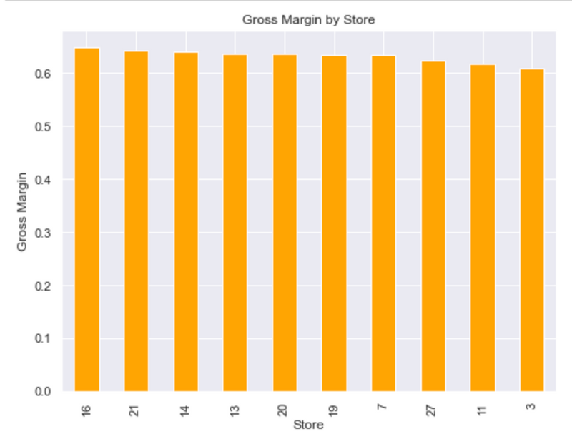
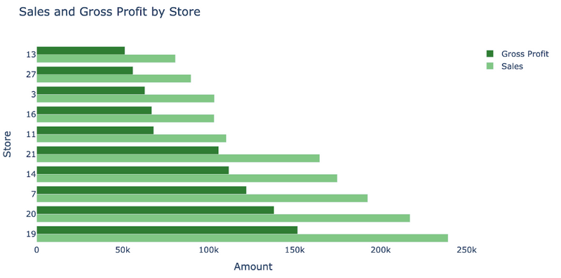

DESCRIPTIVE SUMMARY
Store 19 -highest sales $239,191.94 and gross profit $151,730.00.
Store 13 lowest sales $80,598.48 and gross profit, $51,317.70.
Gross margin % across 10 stores

Slide 5
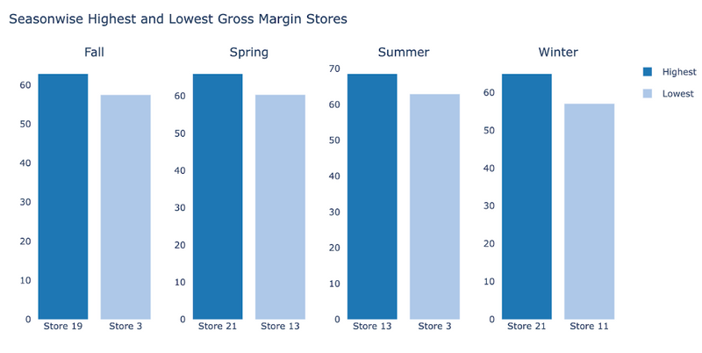
DESCRIPTIVE SUMMARY
Highest - Store 13 in Summer, GM of 68%.
Lowest - Store 11 during Winter, GM of 57%

Slide 6
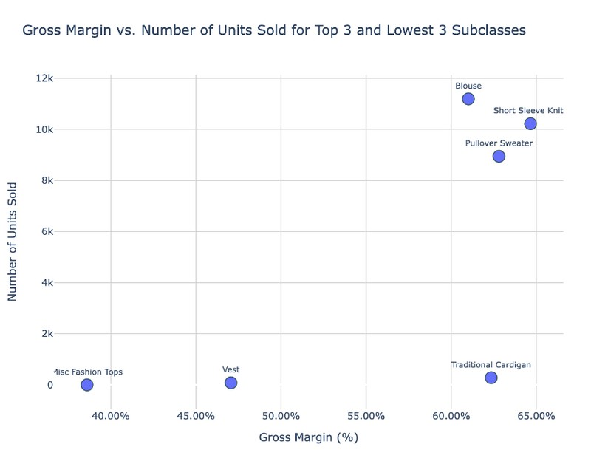
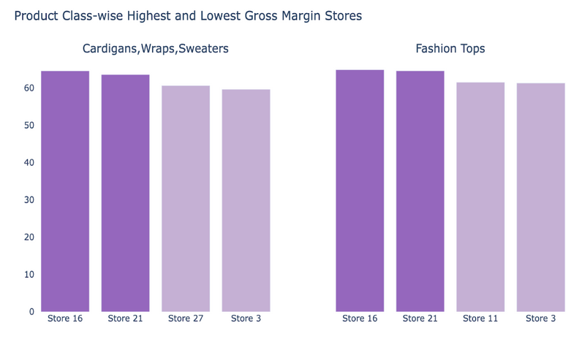
DESCRIPTIVE SUMMARY
Cardigans, Wraps, Sweaters- Highest GM by Store 16 at 64.58%, Lowest GM by Store 3 at 59.64%.
Blouse subclass - Highest number of units sold at 11,191 units, with a GM of 61.00%.
Misc Fashion Tops subclass -Lowest number of units sold with only 2 units, with GM of 38.60%.
Fashion Tops" category-
Highest GM by Store 16 at 64.88%, Lowest GM by Store 3 at 61.32%.

Slide 7
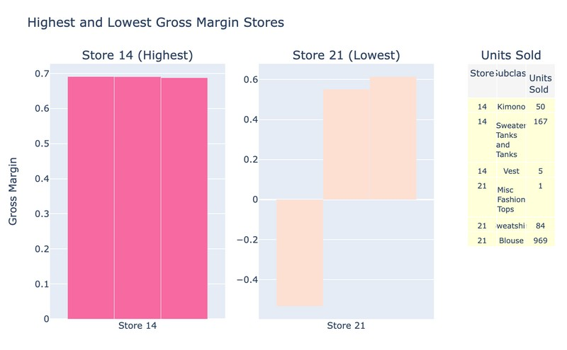
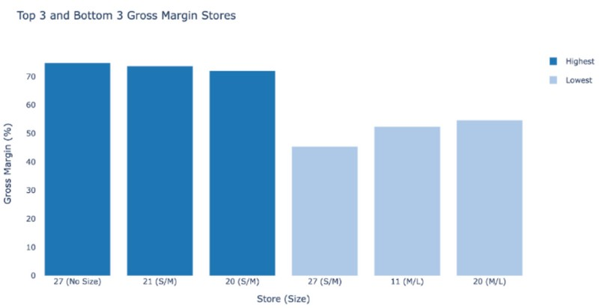

DESCRIPTIVE SUMMARY
Top 3 stores with highest GM are stores 27(74%),store 21(73%), and store 20 (72%) .
Store 14 - Highest-margin store
GM of 69.12% for Kimono, with 50 units sold.
Store 21- lowest-margin store
GM of -53.33% for Misc Fashion Tops, with only 1 unit sold.
Bottom 3 stores with lowest GM are store 27(45%), store 11 (52%), and store 20 (54%).

Slide 8
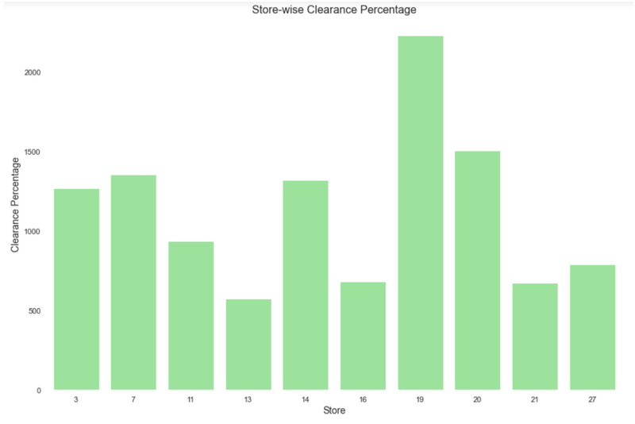
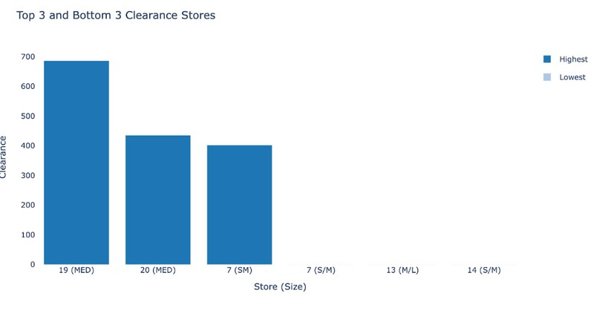
DESCRIPTIVE SUMMARY
Store-wise Clearance Percentage
Store 19 - highest clearance with 2230 products.
Top 3 and Bottom 3 Clearance Stores
Highest clearance -Store 19 with a clearance of 686
Lowest clearance are Store 7 ,13 and 14 with a clearance of 0.
Store 13 -lowest clearance with 575 products.

Slide 9
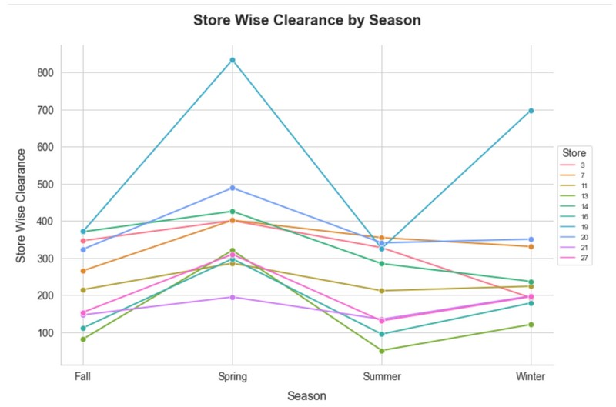
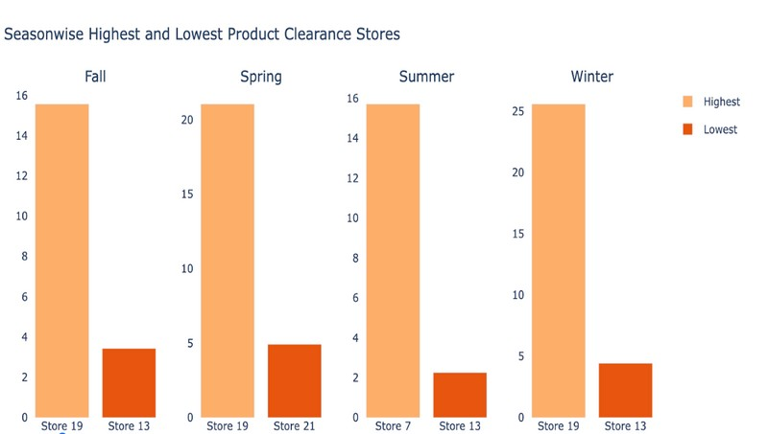
DESCRIPTIVE SUMMARY
Highest clearance in Fall : Store 19 with clearance of 15.56 %, Lowest clearance store : Store 13 with a clearance of 3.43.%
Highest product clearance in Winter : Store 19 with 25.59 % Lowest clearance store: Store 13 with a clearance of 4.44 %

Slide 10



CLUSTERING ANALYSIS
Reason we use cluster analysis:
Logistic Regression on Merged dataset -> Insignificant F1 score -> Probable Reason: Different significant variables for different stores
Clustering done to find out natural groups within dataset.
Goal: To segment the stores or products into groups with similar characteristics -> provide insights into their performance and the factors driving clearance sales.
Focus on two major groups : High Clearance items and Low Clearance items Clustering with K value of 2, gave promising result that met our goal.
Cluster
Product on Clearance
High
Low
Avg.Gross Margin.
Low
High
Inventory (XS, XXS, XL)
High
Low
Inventory (M/L)
Low
High
Avg.unit Cost
Popular Product Types
Avg.Sales Amt.
1
2
Low
High
Low
High
Blouse, Bodysuits, Long Sleeve Knit
Button Down, Cardigans, Short Sleeve Knits, Woven Tanks, Vest

Slide 11

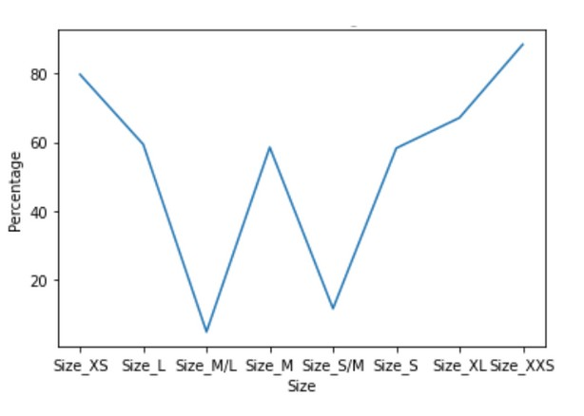


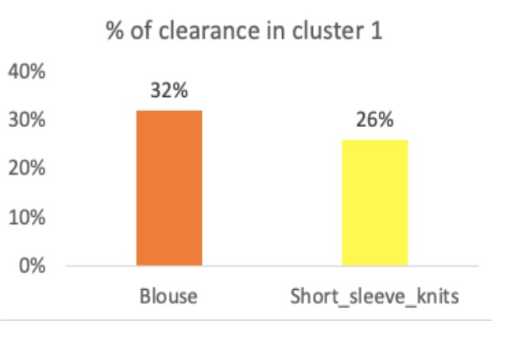
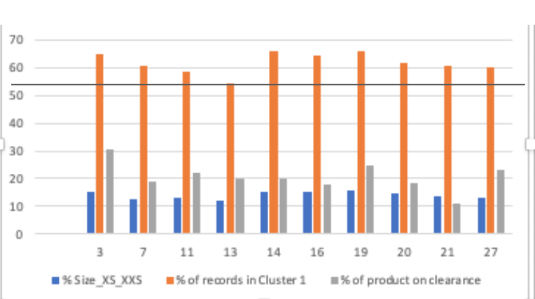



ANALYSIS AND RECOMMENDATIONS BASED ON CLUSTERS
Standardization to the level of store 13
Size v.s. Product Clearance
Cluster 1 : 80% or more of XS & XXS size in product subclasses.
Low margin, higher clearance or combination of both.
Stores should be vigilant in keeping the excess inventory of these sizes product.
Decrease inventory of Size_XXS,XS.
Standardization to the level of store 13
Store 13 , in cluster 1 with lowest records, has the least number of XS, XXS size products.
GM is also good (63.8%).
Other stores can match their size combination across their products & target the level of store 13.
% of Blouse and Short sleeve Knits
Blouse and Short_sleeve_Knits make around 60% of the product put on clearance in cluster 1. These product subclasses was further studied for the re- allocation between the stores.

Slide 12




PREDICTIVE MODEL
Logistic Regression Model:
Cluster 1 (Low Gross Margin - High Product Clearance) Cluster 2 (High Gross Margin - Low Product Clearance)
Independent variables: “gross margin”, dummies for season, for product class, size, and for colors. Predicting “Product Clearance” flag.
Highlights
Cluster 1
Cluster 2
Gross_margin: Negative ->
If increases, probability of a product being on clearance decreases.
Spring / Winter: Positive ->
Products sold in Spring/Winter are more likely to be on clearance than products sold in other seasons.
Cardigans / Sweaters: Positive -> Products categorized as Short
Cardigans are more likely to be on clearance than other product categories.
Significant Variables:
Gross_margin: -10.153 (p-value=0.000*)
Significant Variables:
Gross_margin: -12.948 (p-value=0.000*)
Spring: 3.464 (p-value=0.001*)
Winter: 2.411 (p-value=0.016*)
Cardigans: 2.483 (p-value=0.013*)
Sweaters: 2.024 (p-value=0.043*)

Slide 13
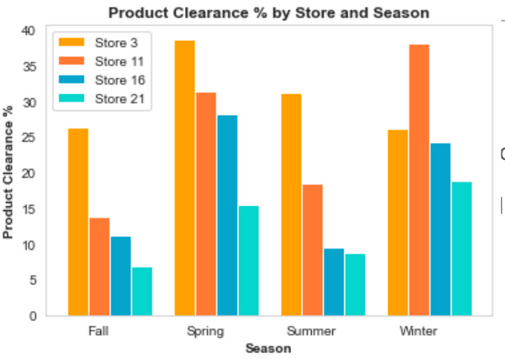
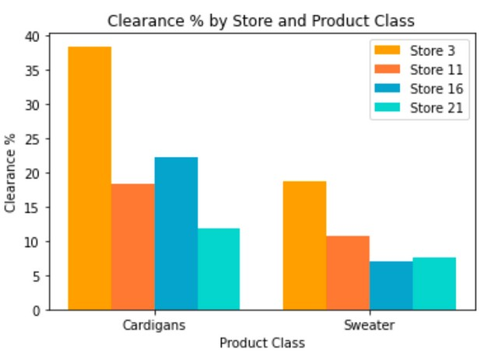
PREDICTIVE MODEL
Cluster 1
Cluster 2
Models have good F1 score and Accuracy rate:
Measures:
F1 Score: 0.81
Accuracy: 0.91
Precision: 0.94
Recall: 0.71
Measures:
F1 Score: 0.81
Accuracy: 0.96
Precision: 0.93
Recall: 0.70
Correctly identifying products on clearance and correctly identifying products not on clearance.
Actionable takeaways based on the regression model:
Stores with low gross margin and high product clearance can focus offering Clearance Products in the seasons of Spring and Winter, and decrease their clearance items during Summer and Fall.
Both clusters can decrease their inventory of Cardigans and Sweaters to reduce the clearance rate.

Slide 14

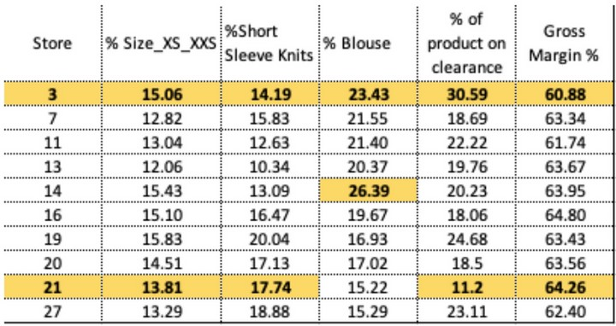

CONCLUSION
Business recommendations
Bring down the percentage of XS/XXS size product class across store, and allocate most of XS/XXS size product class to the store 21 from store 3.
Decreasing the inventory of blouse,and reallocate some of the inventory to store 14 from store 3.
Decrease the inventory of Short sleeve knits and reallocate some of the inventory to store 21 from store 3.
Future Scope and Study:
Finding out the optimum re-allocation
Estimating the impact on the revenue and gross margin based on the re-allocation.

